Slide 1

Arts & Culture, Business and Health & Wellness

Slide 2
What is SHSM?

Slide 3

It’s a 2 year program designed for to prepare you for your chosen post-secondary pathway
Notes:
SHSM provides programming for all four post-secondary destinations.
Keeping in mind that pathways are unique and individual to each student, starting points begin with where each student is both academically and socially-emotionally ready.
SHSM programming provides students with the opportunity to select courses that build on their skills, interests and abilities. Many of the courses in an SHSM bundle are required for graduation so students still have lots of choice to take courses that are of interest to them and may be outside of the SHSM.
SHSMs take students on a directed journey of self-discovery, where their destination unfolds.

Slide 4


SHSM will help you focus YOUR high school Career and experiences towards Arts & Culture, Business, Health & Wellness Sectors by assisting you in choosing appropriate courses…..
It also gives you the flexibility to explore other interests as well
Notes:
See slide

Slide 5

Introductory Clip

Slide 6

The Five Parts of SHSM
A bundle of 8-10 Grade 11 and Grade 12 credits.
Sector recognised certifications and training courses
Experiential learning activities within the sector
“Reach Ahead” experiences in the student’s post-secondary destination of choice
Use of the Ontario Skills Passport (OSP) to document development of Essential Skills and work habits.

Slide 7
SHSM Sectors

Slide 8

Arts & Culture Certifications
Three compulsory
Cardiopulmonary Resuscitation (CPR) Level C - including AED
Generic instruction about the Workplace Hazardous Materials Information System (WHMIS)
Standard First Aid
Three Electives
Advanced training in a technique (figure drawing, sewing, etc)
Advanced training in a technology (3D printing, laser cutting, etc.)
Advanced training in an art form (mime, tap dance, improv, etc.)
Advanced training in art therapy
Audition preparation, basic electrical safety
Curatorial techniques
Customer service
Elevated platforms
Event coordination
Framing and matting
Game design
Instructor certification
Lighting and sound
Portfolio development

Slide 9
Business Certifications
Four compulsory
Cardiopulmonary Resuscitation (CPR) Level C including AED
Generic instruction about the Workplace Hazardous Materials Information System (WHMIS)
Customer service
Standard First Aid
Three Electives
Counterfeit detection
Health and safety – basic
Management/ leadership
Personality inventory
Retail representative
Software
Successful exhibiting
Summer Company Program

Slide 10
Health and Wellness Certifications
Four compulsory
Cardiopulmonary Resuscitation (CPR) Level C including AED
Generic instruction about the Workplace Hazardous Materials Information System (WHMIS)
Infection control
Standard First Aid
Three Electives
Marine & wilderness first aid
Medical terminology
Non-violent crisis intervention
Personality inventory
Safe body mechanics
Safe food handling – basic
Sign language
Specialized care
Sterile techniques
suicide prevention
Waste management
Marine & wilderness first aid
sign language
Specialized care (e.g., diabetes, dementia)
Sterile techniques
Suicide prevention
Waste management
Medical terminology
Non-violent crisis intervention
Personality inventory
Safe body mechanics
Safe food handling – basic

Slide 11
Pathways

Slide 12


Slide 13

Notes:
Refer to brochure

Slide 14


Slide 15
Frequently Asked Questions

Slide 16
What Are the Benefits of SHSM?
Co-op Workplace Education
Recognized by Universities and Colleges across Ontario
Sector Specific Workshops and Training
Reach Aheads and Experiential Learning

Slide 17
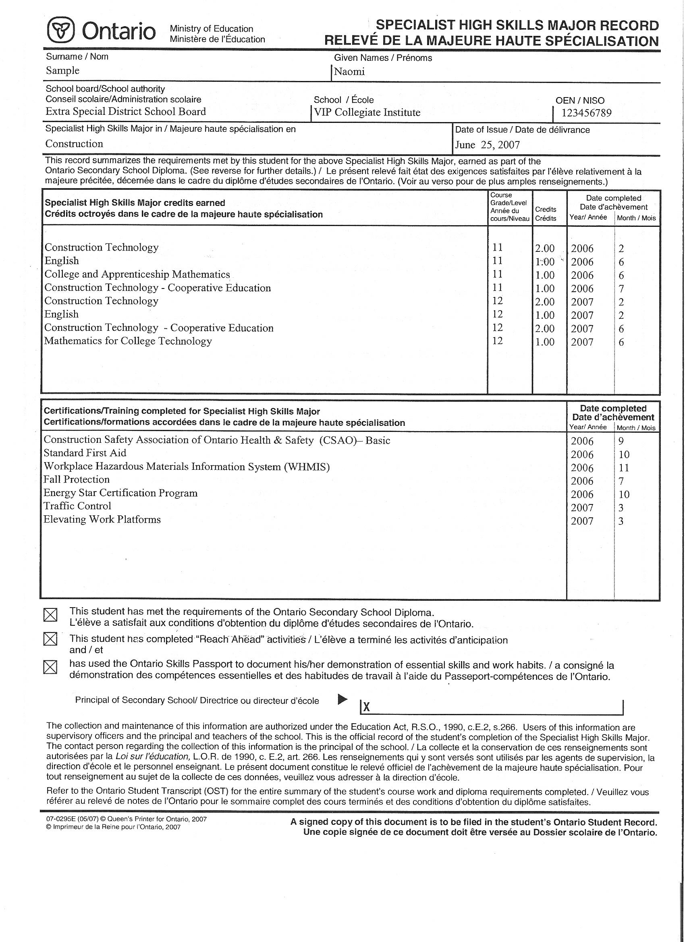

SHSM Recognition
Notes:
Students go through a formal application and interview process to be eligible for admission to our SHSM program.
Students and parents see the value in the red seal and the SHSM Record.
SHSM students are recognised at graduation ceremonies
A SHSM bursary has been established.
Each school awards a trophy for the student who best demonstrates attainment of the essential skills.

Slide 18
How do I Apply?
Register by filling out the Google Form.
You can find the link in the Guidance Office or on our Facebook Page.
For more information make an appointment to speak to your Guidance counsellor
Notes:
FAQ 1) How to Apply 2) Why should i apply 3) Benefits of Coop 4)

Slide 19
We Hope to See You Soon!

